Slide 1
Applied Cryptography cryptanalysis of the Hill cipher and LFSR, discrete probability
Liangfeng Zhang
School of Information Science and Technology
ShanghaiTech University

Slide 2
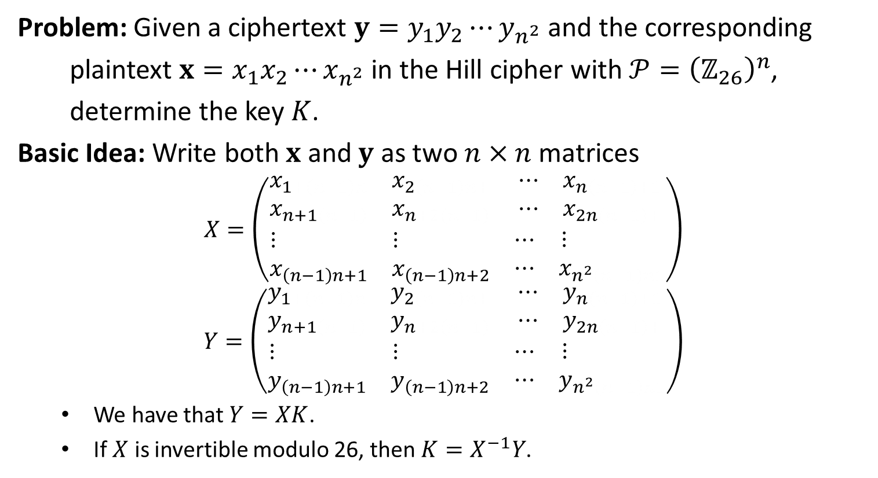
Cryptanalysis of the Hill Cipher
Problem: Given a ciphertext ${y=y}_{1}y_{2}⋯y_{n^{2}}$ and the corresponding
plaintext $x=x_{1}x_{2}⋯x_{n^{2}}$ in the Hill cipher with $𝒫={\left(ℤ_{26}\right)}^{n}$,
determine the key $K$.
Basic Idea: Write both $x$ and $y$ as two $n×n$ matrices
$$X=\left(\begin{matrix}\begin{matrix}x_{1+\left(n−1\right)n} & x_{2\left(n−1\right)n+} \\ x_{n+1\left(n−1\right)} & x_{n+2\left(n−1\right)}\end{matrix} & \begin{matrix}⋯ & x_{n\left(n−1\right)+1} \\ ⋯ & x_{2n\left(n−1\right)+}\end{matrix} \\ \begin{matrix}⋮ & ⋮ \\ x_{\left(n−1\right)n+1} & x_{\left(n−1\right)n+2}\end{matrix} & \begin{matrix}⋯ & ⋮ \\ ⋯ & x_{n^{2}\left(n−1\right)n1}\end{matrix}\end{matrix}\right)$$
$$Y=\left(\begin{matrix}\begin{matrix}y_{1+\left(n−1\right)n} & y_{2\left(n−1\right)n+} \\ y_{n+1\left(n−1\right)} & y_{n+2\left(n−1\right)}\end{matrix} & \begin{matrix}⋯ & y_{n\left(n−1\right)+1} \\ ⋯ & y_{2n\left(n−1\right)+}\end{matrix} \\ \begin{matrix}⋮ & ⋮ \\ y_{\left(n−1\right)n+1} & y_{\left(n−1\right)n+2}\end{matrix} & \begin{matrix}⋯ & ⋮ \\ ⋯ & y_{n^{2}\left(n−1\right)n1}\end{matrix}\end{matrix}\right)$$
We have that $Y=XK$.
If $X$ is invertible modulo 26, then $K=X^{−1}Y$.

Slide 3
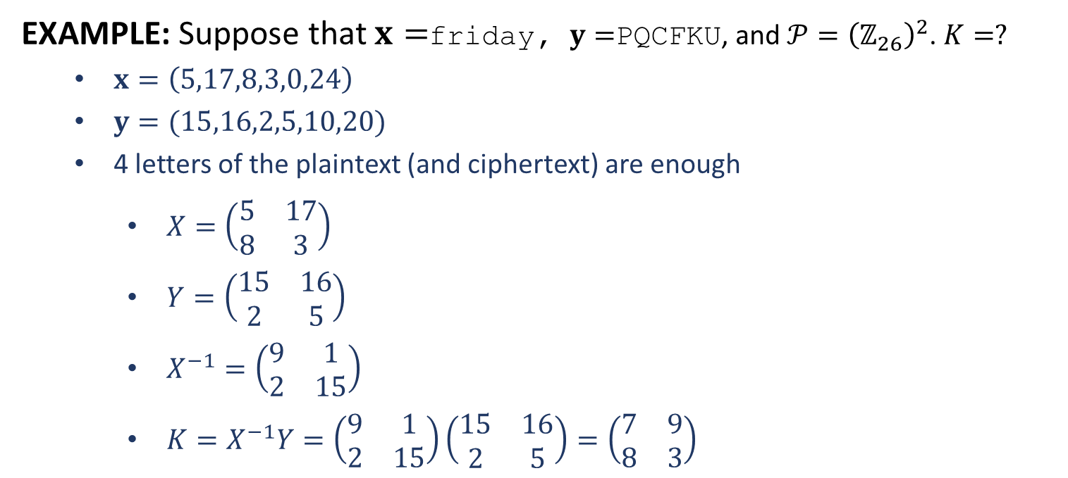
Cryptanalysis of the Hill Cipher
EXAMPLE: Suppose that $x=$friday, $y=$PQCFKU, and $𝒫={\left(ℤ_{26}\right)}^{2}$. $K=?$
$x=\left(5,17,8,3,0,24\right)$
$y=(15,16,2,5,10,20)$
4 letters of the plaintext (and ciphertext) are enough
$X=\left(\begin{matrix}5 & 17 \\ 8 & 3\end{matrix}\right)$
$Y=\left(\begin{matrix}15 & 16 \\ 2 & 5\end{matrix}\right)$
$X^{−1}=\left(\begin{matrix}9 & 1 \\ 2 & 15\end{matrix}\right)$
$K=X^{−1}Y=\left(\begin{matrix}9 & 1 \\ 2 & 15\end{matrix}\right)\left(\begin{matrix}15 & 16 \\ 2 & 5\end{matrix}\right)=\left(\begin{matrix}7 & 9 \\ 8 & 3\end{matrix}\right)$

Slide 5
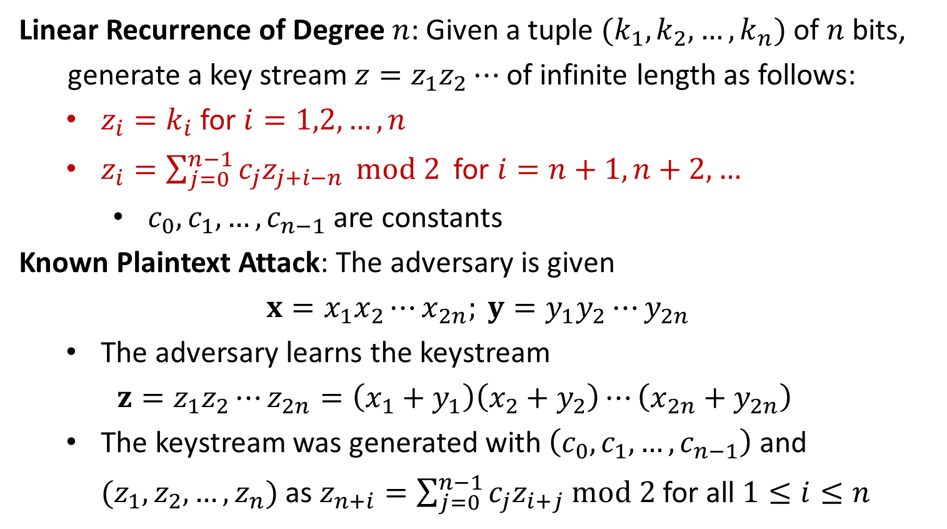

Cryptanalysis of the LFSR
Linear Recurrence of Degree $n$: Given a tuple $(k_{1},k_{2},…,k_{n})$ of $n$ bits,
generate a key stream $z=z_{1}z_{2}⋯$ of infinite length as follows:
$z_{i}=k_{i}$ for $i=1,2,…,n$
$z_{i}=\sum_{j=0}^{n−1}{c_{j}z_{j+i−n}} mod 2$ for $i=n+1,n+2, …$
$c_{0},c_{1},…,c_{n−1}$ are constants
Known Plaintext Attack: The adversary is given
$$x=x_{1}x_{2}⋯x_{2n}; y=y_{1}y_{2}⋯y_{2n}$$
The adversary learns the keystream
$$z=z_{1}z_{2}⋯z_{2n}=\left(x_{1}+y_{1}\right)\left(x_{2}+y_{2}\right)⋯\left(x_{2n}+y_{2n}\right)$$
The keystream was generated with $\left(c_{0},c_{1},…,c_{n−1}\right)$ and $(z_{1},z_{2},…,z_{n})$ as $z_{n+i}=\sum_{j=0}^{n−1}{c_{j}z_{i+j} mod 2}$ for all $1≤i≤n$
$$=y_{1}−x_{1}$$

Slide 6
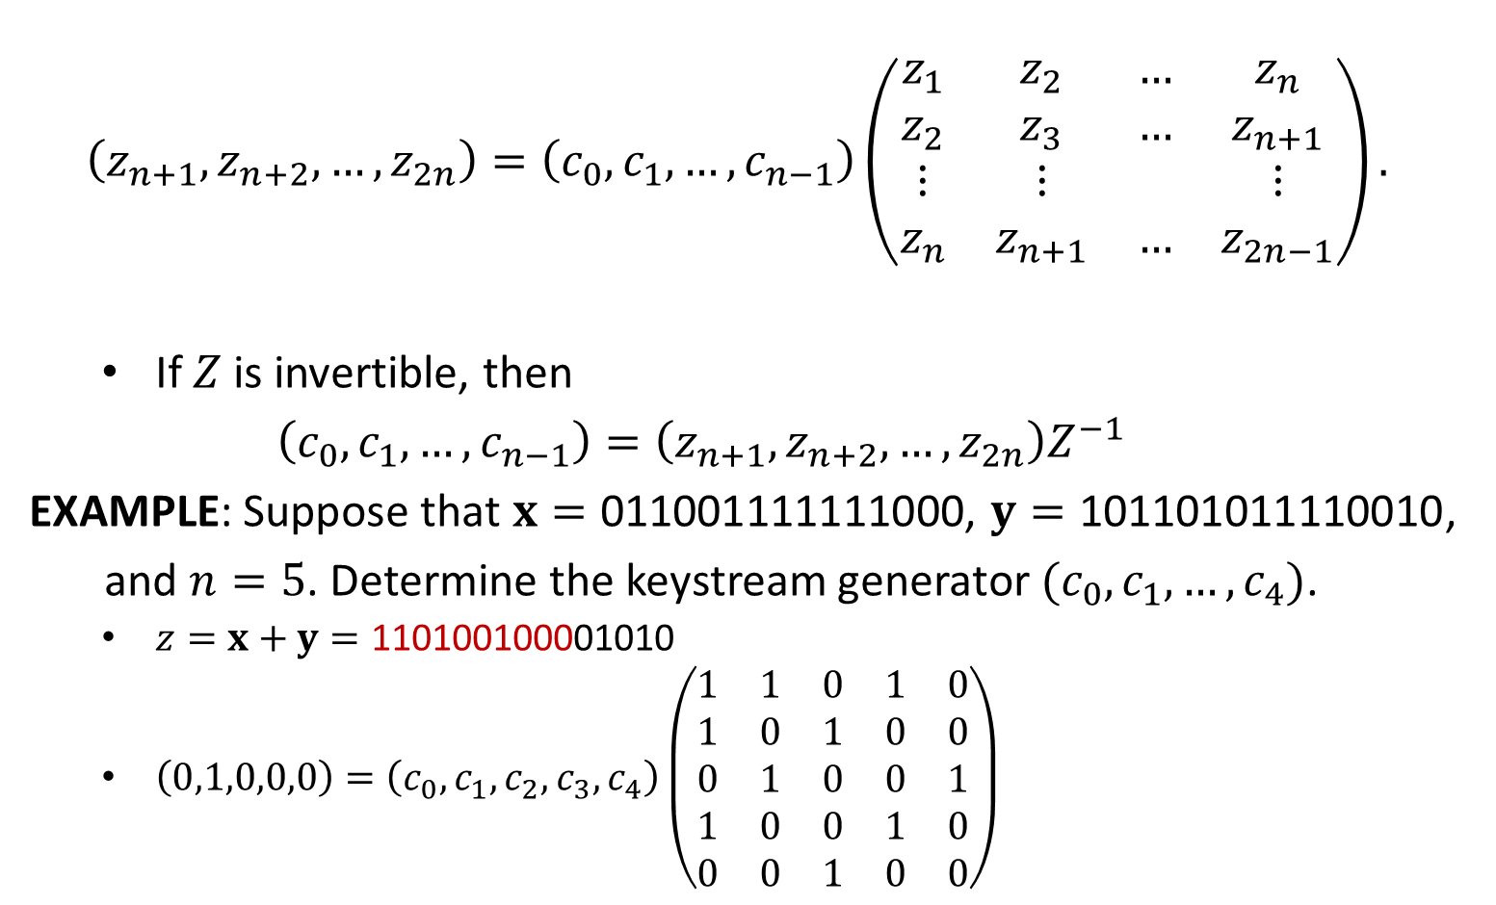

Cryptanalysis of the LFSR
$$\left(z_{n+1},z_{n+2},…,z_{2n}\right)=\left(c_{0},c_{1},…,c_{n−1}\right)\left(\begin{matrix}z_{1} & z_{2} & … & z_{n} \\ z_{2} & z_{3} & … & z_{n+1} \\ ⋮ & ⋮ & & ⋮ \\ z_{n} & z_{n+1} & … & z_{2n−1}\end{matrix}\right).$$
If $Z$ is invertible, then
$$\left(c_{0},c_{1},…,c_{n−1}\right)=\left(z_{n+1},z_{n+2},…,z_{2n}\right)Z^{−1}$$
EXAMPLE: Suppose that $x=\text{0110011111}\text{11000}\text{,}$ $y=$ $\text{101101011110010}$,
and $n=5$. Determine the keystream generator $(c_{0},c_{1},…,c_{4})$.
$z=x+y=\text{1101001000}\text{01010}$
$\left(0,1,0,0,0\right)=\left(c_{0},c_{1},c_{2},c_{3},c_{4}\right)\left(\begin{matrix}1 & 1 & 0 & 1 & 0 \\ 1 & 0 & 1 & 0 & 0 \\ 0 & 1 & 0 & 0 & 1 \\ 1 & 0 & 0 & 1 & 0 \\ 0 & 0 & 1 & 0 & 0\end{matrix}\right)$
$$Z$$

Slide 7

Cryptanalysis of the LFSR
${\left(\begin{matrix}1 & 1 & 0 & 1 & 0 \\ 1 & 0 & 1 & 0 & 0 \\ 0 & 1 & 0 & 0 & 1 \\ 1 & 0 & 0 & 1 & 0 \\ 0 & 0 & 1 & 0 & 0\end{matrix}\right)}^{−1}=\left(\begin{matrix}0 & 1 & 0 & 0 & 1 \\ 1 & 0 & 0 & 1 & 0 \\ 0 & 0 & 0 & 0 & 1 \\ 0 & 1 & 0 & 1 & 1 \\ 1 & 0 & 1 & 1 & 0\end{matrix}\right)$
$\left(c_{0},c_{1},c_{2},c_{3},c_{4}\right)=\left(0,1,0,0,0\right)\left(\begin{matrix}0 & 1 & 0 & 0 & 1 \\ 1 & 0 & 0 & 1 & 0 \\ 0 & 0 & 0 & 0 & 1 \\ 0 & 1 & 0 & 1 & 1 \\ 1 & 0 & 1 & 1 & 0\end{matrix}\right)$
$=\left(1,0,0,1,0\right)$
How to calculate the inverse of a square matrix modulo 2?
Gaussian Elimination
Summary of Classical Cryptography
All ciphers in classical cryptography have been BADLY broken
Under COA or KPA, the adversary is able to recover the secret key
Conclusion: Classical cryptography is art, not science
no formal definition of security
no security proof

Slide 9
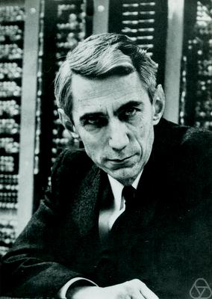
Scientific Study of Cryptography
Claude E. Shannon (1916-2001)
Defined “Perfect Secrecy”
in 1945 (declassified in 1949)

Slide 10
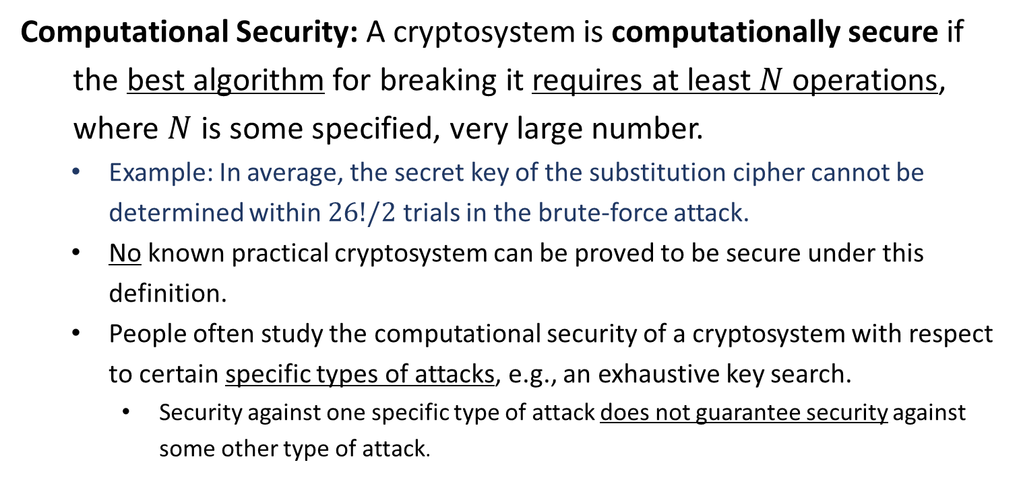
Security
Computational Security: A cryptosystem is computationally secure if
the best algorithm for breaking it requires at least $N$ operations,
where $N$ is some specified, very large number.
Example: In average, the secret key of the substitution cipher cannot be determined within $26!/2$ trials in the brute-force attack.
No known practical cryptosystem can be proved to be secure under this definition.
People often study the computational security of a cryptosystem with respect to certain specific types of attacks, e.g., an exhaustive key search.
Security against one specific type of attack does not guarantee security against some other type of attack.

Slide 11
Security
Provable Security: A cryptosystem can be “broken” in some specific way,
then it would be possible to efficiently solve some well-studied
problem that is thought to be difficult. Cryptosystems of this type
are termed as provably secure.
Example: If ElGamal encryption can be broken in some specific way, then the DDH problem in a cyclic group can be efficiently solved.
The proof is relative to some other problem, not an absolute proof of security.
Like the proof for NP completeness.
The proof is done by constructing a reduction between two problems.
One is breaking the cryptosystem
The other is solving the well-studied problem.

Slide 12
Security
Unconditional Security: A cryptosystem is unconditionally secure if it
cannot be broken, even the adversary has infinite computational
resources.
Example: Shannon’s perfect secrecy
Provably secure cryptosystems may be not unconditionally secure at all.
The adversary has infinite computational resources, such as time and space.
The adversary is strong enough to solve the hard problem.
RAMARK: When we are talking about the security of a cryptosystem,
we need to specify the type attack that is being considered.
Example: None of the shift cipher, the substitution cipher, and Vigenère Cipher is computationally secure under COA.

Slide 14
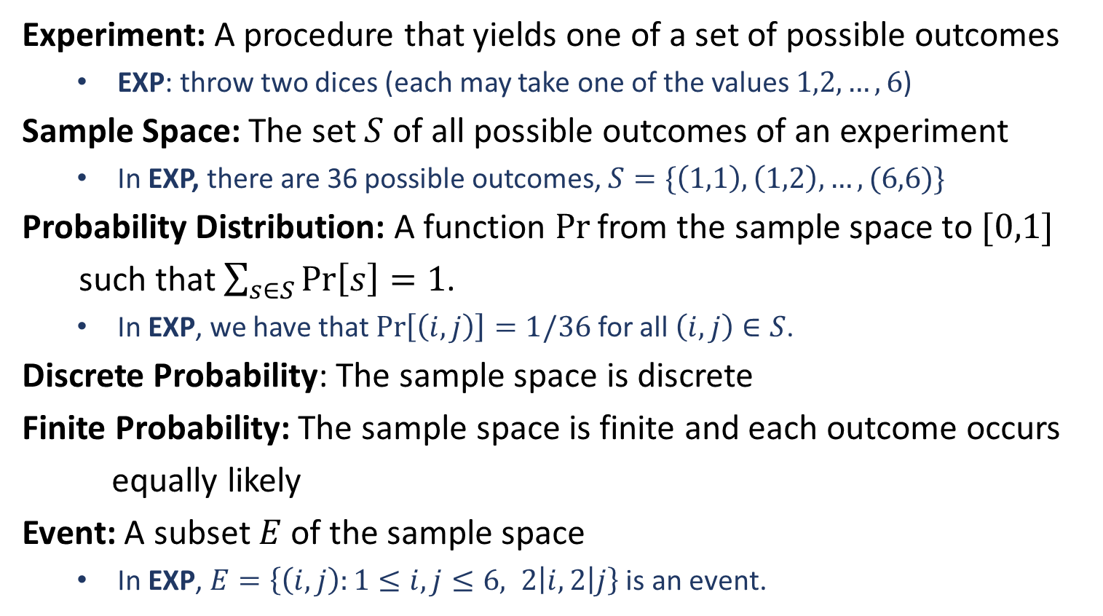
Discrete Probability
Experiment: A procedure that yields one of a set of possible outcomes
EXP: throw two dices (each may take one of the values $1,2,…,6$)
Sample Space: The set $S$ of all possible outcomes of an experiment
In EXP, there are 36 possible outcomes, $S=\{\left(1,1\right),\left(1,2\right),…,(6,6)\}$
Probability Distribution: A function $Pr$ from the sample space to $[0,1]$
such that $\sum_{s∈S}{\operatorname{Pr}\left[s\right]}=1$.
In EXP, we have that $\operatorname{Pr}\left[\left(i,j\right)\right]=1/36$ for all $\left(i,j\right)∈S$.
Discrete Probability: The sample space is discrete
Finite Probability: The sample space is finite and each outcome occurs
equally likely
Event: A subset $E$ of the sample space
In EXP, $E=\left\{\left(i,j\right):1≤i,j≤6, 2\left|i, 2\right|j\right\}$ is an event.

Slide 15
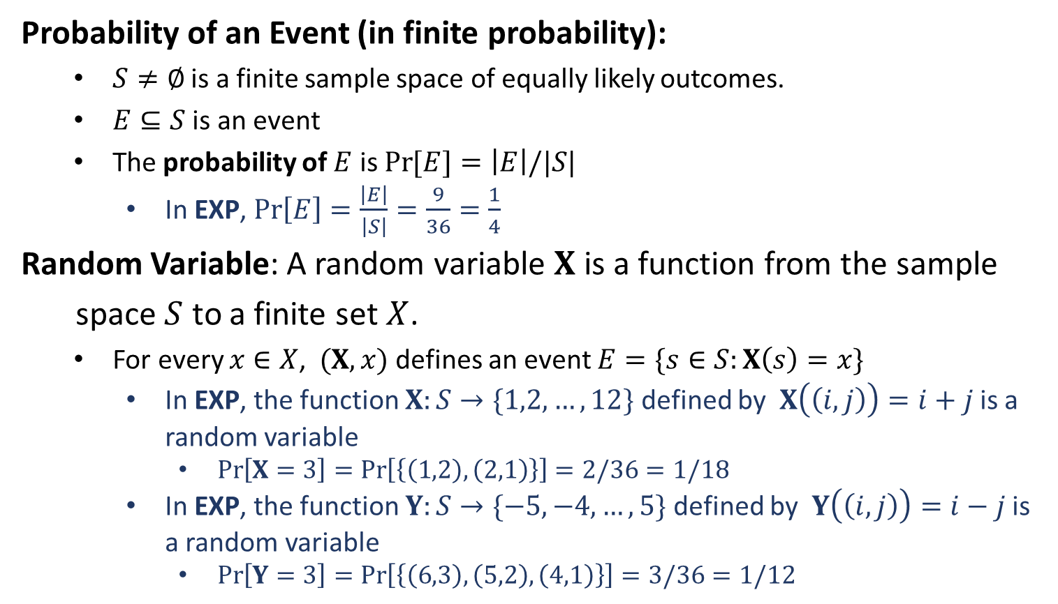
Discrete Probability
Probability of an Event (in finite probability):
$S≠∅$ is a finite sample space of equally likely outcomes.
$E⊆S$ is an event
The probability of $E$ is $\operatorname{Pr}{[E]}=\left|E\right|/|S|$
In EXP, $\operatorname{Pr}\left[E\right]=\frac{\left|E\right|}{\left|S\right|}=\frac{9}{36}=\frac{1}{4}$
Random Variable: A random variable $X$ is a function from the sample
space $S$ to a finite set $X$.
For every $x∈X$, $(X,x)$ defines an event $E=\{s∈S:X\left(s\right)=x\}$
In EXP, the function $X:S→\{1,2,…,12\}$ defined by $X\left(\left(i,j\right)\right)=i+j$ is a random variable
$\operatorname{Pr}\left[X=3\right]=\operatorname{Pr}\left[\left\{\left(1,2\right),\left(2,1\right)\right\}\right]=2/36=1/18$
In EXP, the function $Y:S→\{−5,−4,…,5\}$ defined by $Y\left(\left(i,j\right)\right)=i−j$ is a random variable
$\operatorname{Pr}\left[Y=3\right]=\operatorname{Pr}\left[\left\{\left(6,3\right),\left(5,2\right),\left(4,1\right)\right\}\right]=3/36=1/12$

Slide 16
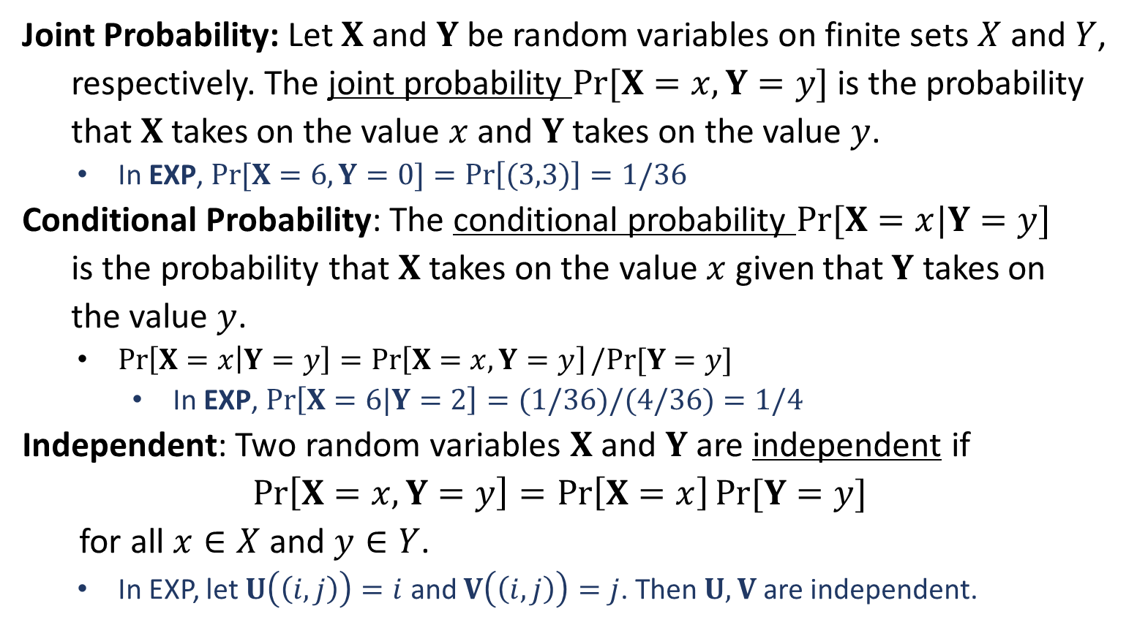
Discrete Probability
Joint Probability: Let $X$ and $Y$ be random variables on finite sets $X$ and $Y$,
respectively. The joint probability $Pr[X=x,Y=y]$ is the probability
that $X$ takes on the value $x$ and $Y$ takes on the value $y$.
In EXP, $\operatorname{Pr}{[X=6, Y=0}]=\operatorname{Pr}\left[(3,3)\right]=1/36$
Conditional Probability: The conditional probability $Pr⁡[X=x|Y=y]$
is the probability that $X$ takes on the value $x$ given that $Y$ takes on
the value $y$.
$\operatorname{Pr}\left[X=x | Y=y\right]=\operatorname{Pr}\left[X=x,Y=y\right]/Pr⁡[Y=y]$
In EXP, $\operatorname{Pr}\left[X=6|Y=2\right]=(1/36)/(4/36)=1/4$
Independent: Two random variables $X$ and $Y$ are independent if
$$\operatorname{Pr}\left[X=x,Y=y\right]=\operatorname{Pr}\left[X=x\right]Pr⁡[Y=y]$$
for all $x∈X$ and $y∈Y$.
In EXP, let $U\left(\left(i,j\right)\right)=i$ and $V\left(\left(i,j\right)\right)=j$. Then $U,V$ are independent.

Slide 17
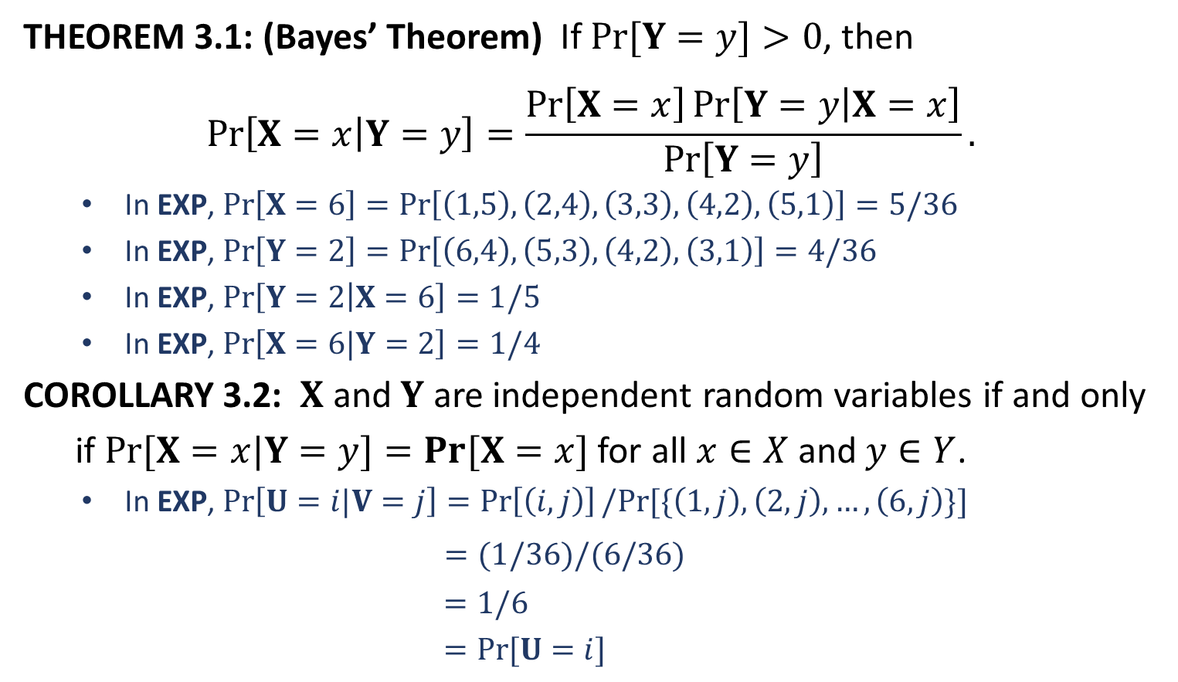
Discrete Probability
THEOREM 3.1: (Bayes’ Theorem) If $Pr[Y=y]>0$, then
$$\operatorname{Pr}\left[X=x | Y=y\right]=\frac{\operatorname{Pr}\left[X=x\right]\operatorname{Pr}\left[Y=y | X=x\right]}{\operatorname{Pr}\left[Y=y\right]}.$$
In EXP, $\operatorname{Pr}\left[X=6\right]=\operatorname{Pr}\left[\left(1,5\right),\left(2,4\right),\left(3,3\right),\left(4,2\right),\left(5,1\right)\right]=5/36$
In EXP, $\operatorname{Pr}\left[Y=2\right]=\operatorname{Pr}\left[\left(6,4\right),\left(5,3\right),\left(4,2\right),\left(3,1\right)\right]=4/36$
In EXP, $\operatorname{Pr}\left[Y=2 | X=6\right]=1/5$
In EXP, $\operatorname{Pr}\left[X=6|Y=2\right]=1/4$
COROLLARY 3.2: $X$ and $Y$ are independent random variables if and only
if $Pr⁡[X=x|Y=y]=Pr⁡[X=x]$ for all $x∈X$and $y∈Y$.
In EXP, $\operatorname{Pr}\left[U=i|V=j\right]=\operatorname{Pr}\left[\left(i,j\right)\right]/Pr⁡[\{\left(1,j\right),\left(2,j\right),…,\left(6,j\right)\}]$
$=(1/36)/(6/36)$
$=1/6$
$=Pr⁡[U=i]$

Slide 18
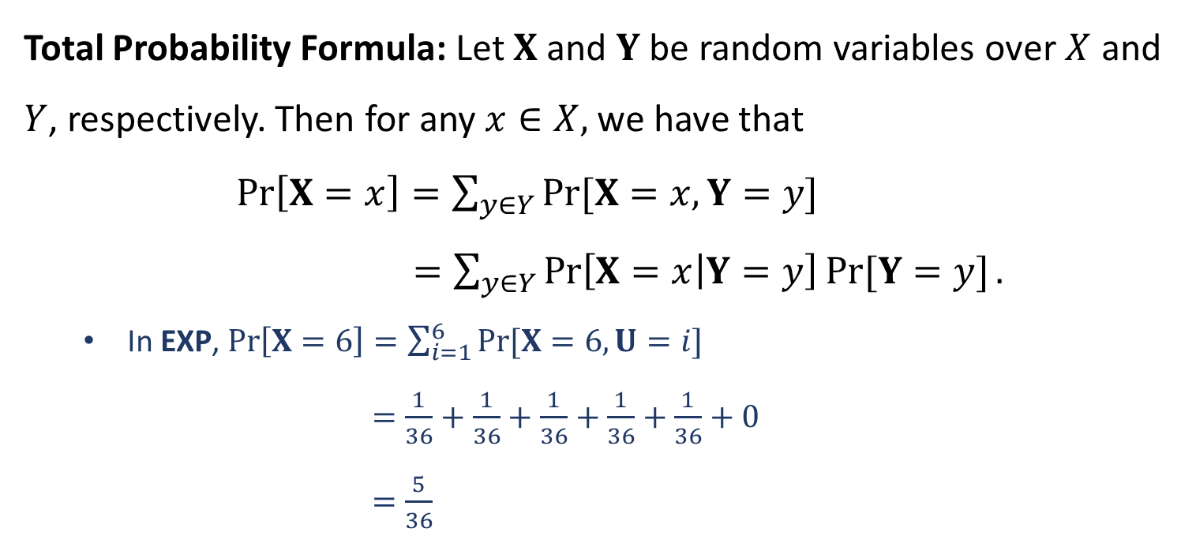
Discrete Probability
Total Probability Formula: Let $X$ and $Y$ be random variables over $X$ and $Y$, respectively. Then for any $x∈X,$ we have that
$\operatorname{Pr}\left[X=x\right]=\sum_{y∈Y}{\operatorname{Pr}{[X=x,Y=y]}}$
$=\sum_{y∈Y}{\operatorname{Pr}\left[X=x | Y=y\right]Pr⁡[Y=y]}.$
In EXP, $\operatorname{Pr}\left[X=6\right]=\sum_{i=1}^{6}{\operatorname{Pr}{[X=6,U=i]}}$
$=\frac{1}{36}+\frac{1}{36}+\frac{1}{36}+\frac{1}{36}+\frac{1}{36}+0$
$=\frac{5}{36}$

Slide 20
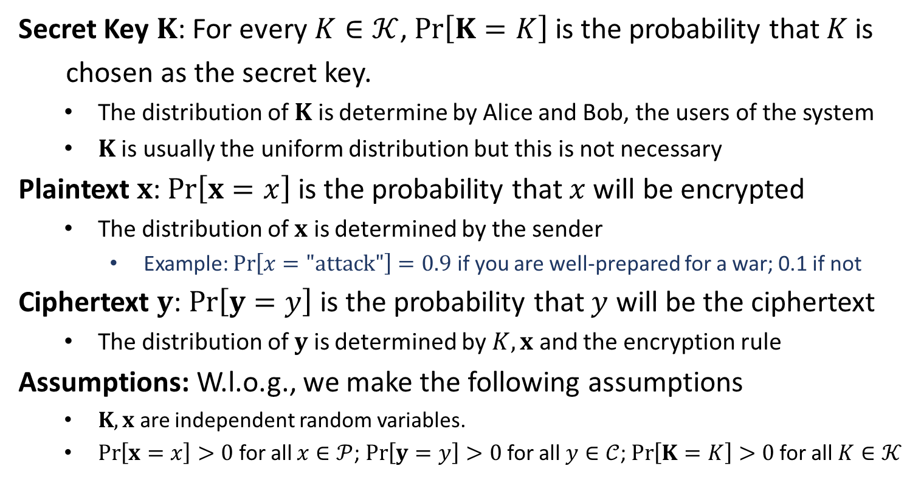
Random Variables in Cryptosystem
Secret Key $K$: For every $K∈𝒦$, $\operatorname{Pr}\left[K=K\right]$ is the probability that $K$ is
chosen as the secret key.
The distribution of $K$ is determine by Alice and Bob, the users of the system
$K$ is usually the uniform distribution but this is not necessary
Plaintext $x$: $\operatorname{Pr}\left[x=x\right]$ is the probability that $x$ will be encrypted
The distribution of $x$ is determined by the sender
Example: $\operatorname{Pr}\left[x="\text{attack}"\right]=0.9$ if you are well-prepared for a war; 0.1 if not
Ciphertext $y$: $\operatorname{Pr}\left[y=y\right]$ is the probability that $y$ will be the ciphertext
The distribution of $y$ is determined by $K,x$ and the encryption rule
Assumptions: W.l.o.g., we make the following assumptions
$K,x$ are independent random variables.
$\operatorname{Pr}\left[x=x\right]>0$ for all $x∈𝒫$; $\operatorname{Pr}\left[y=y\right]>0$ for all $y∈𝒞$; $\operatorname{Pr}\left[K=K\right]>0$ for all $K∈𝒦$

Slide 21
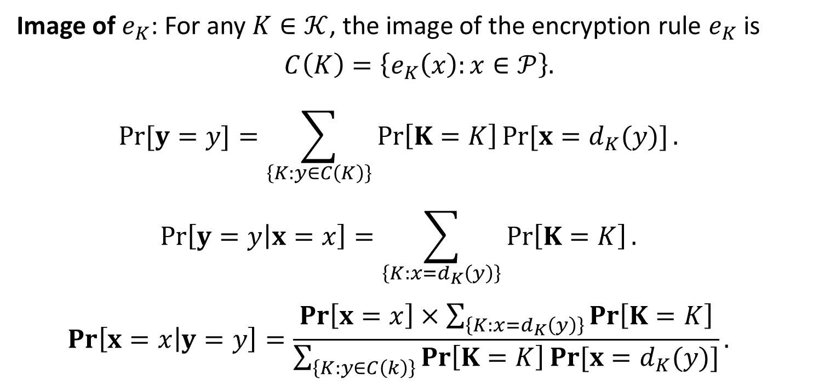
Calculation of Probabilities
Image of $e_{K}$: For any $K∈𝒦$, the image of the encryption rule $e_{K}$ is
$$C\left(K\right)=\left\{e_{K}\left(x\right):x∈𝒫\right\}.$$
$$\operatorname{Pr}{[y=y]}=\sum_{\left\{K:y∈C\left(K\right)\right\}}{\operatorname{Pr}\left[K=K\right]Pr⁡[x=d_{K}(y)]}.$$
$$\operatorname{Pr}\left[y=y | x=x\right]=\sum_{\left\{K:x=d_{K}\left(y\right)\right\}}{\operatorname{Pr}\left[K=K\right]}.$$
$$\operatorname{Pr}\left[x=x | y=y\right]=\frac{\operatorname{Pr}\left[x=x\right]×\sum_{\left\{K:x=d_{K}\left(y\right)\right\}}{\operatorname{Pr}\left[K=K\right]}}{\sum_{\left\{K:y∈C\left(k\right)\right\}}{\operatorname{Pr}\left[K=K\right]Pr⁡[x=d_{K}(y)]}}.$$

Slide 22
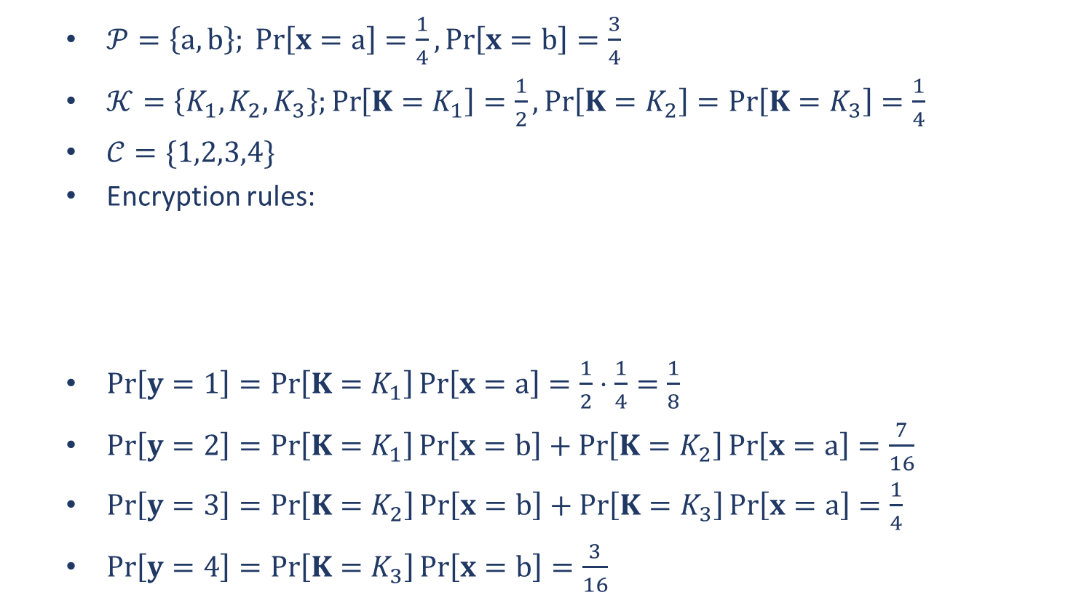
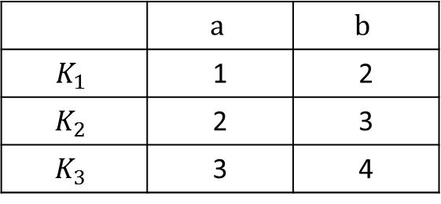
EXAMPLE
$𝒫=\left\{a,b\right\}; \operatorname{Pr}\left[x=a\right]=\frac{1}{4},\operatorname{Pr}\left[x=b\right]=\frac{3}{4}$
$𝒦=\left\{K_{1},K_{2},K_{3}\right\};\operatorname{Pr}\left[K=K_{1}\right]=\frac{1}{2},\operatorname{Pr}\left[K=K_{2}\right]=\operatorname{Pr}\left[K=K_{3}\right]=\frac{1}{4}$
$𝒞=\{1,2,3,4\}$
Encryption rules:
$\operatorname{Pr}\left[y=1\right]=\operatorname{Pr}\left[K=K_{1}\right]\operatorname{Pr}\left[x=a\right]=\frac{1}{2}⋅\frac{1}{4}=\frac{1}{8}$
$\operatorname{Pr}\left[y=2\right]=\operatorname{Pr}\left[K=K_{1}\right]\operatorname{Pr}\left[x=b\right]+\operatorname{Pr}\left[K=K_{2}\right]\operatorname{Pr}\left[x=a\right]=\frac{7}{16}$
$\operatorname{Pr}\left[y=3\right]=\operatorname{Pr}\left[K=K_{2}\right]\operatorname{Pr}\left[x=b\right]+\operatorname{Pr}\left[K=K_{3}\right]\operatorname{Pr}\left[x=a\right]=\frac{1}{4}$
$\operatorname{Pr}\left[y=4\right]=\operatorname{Pr}\left[K=K_{3}\right]\operatorname{Pr}\left[x=b\right]=\frac{3}{16}$
 | $$a$$ | $$b$$
$$K_{1}$$ | 1 | 2
$$K_{2}$$ | 2 | 3
$$K_{3}$$ | 3 | 4

Slide 23

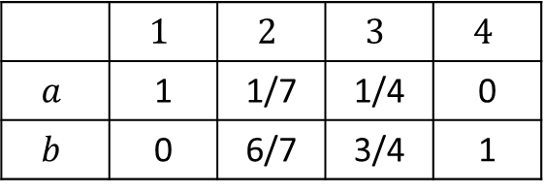
EXAMPLE
$𝒫=\left\{a,b\right\}; \operatorname{Pr}\left[x=a\right]=\frac{1}{4},\operatorname{Pr}\left[x=b\right]=\frac{3}{4}$
$𝒦=\left\{K_{1},K_{2},K_{3}\right\};\operatorname{Pr}\left[K=K_{1}\right]=\frac{1}{2},\operatorname{Pr}\left[K=K_{2}\right]=\operatorname{Pr}\left[K=K_{3}\right]=\frac{1}{4}$
$𝒞=\{1,2,3,4\}$
Encryption rules:
$\operatorname{Pr}\left[x=a|y=1\right]=\operatorname{Pr}\left[x=a\right]\operatorname{Pr}\left[y=1|x=a\right]/\operatorname{Pr}\left[y=1\right]$
$=\frac{1}{4}⋅Pr⁡[K=K_{1}]/(1/8)$
$=1$
 | $$a$$ | $$b$$
$$K_{1}$$ | 1 | 2
$$K_{2}$$ | 2 | 3
$$K_{3}$$ | 3 | 4
 | $$1$$ | $$2$$ | $$3$$ | $$4$$
$$a$$ | 1 | 1/7 | 1/4 | 0
$$b$$ | 0 | 6/7 | 3/4 | 1

